Slide 1
HAND GESTURE RECOGNITION
SUDHEESANA M P
KGISL INSTITUTE OF TECHNOLOGY 711721243111
3/21/2024 Annual Review
1

Slide 2


AGENDA
Identifying the Issue
Overview of the Project
Target Audience
Proposed Solution and its Benefits
Implemented Solution
Approach to Modeling
Achieved Results
3/21/2024 Annual Review
2

Slide 3

PROBLEM STATEMENT
The problem at hand revolves around the need for efficient and accurate hand gesture recognition technology. With the growing prevalence of gesture-based interfaces in various fields such as human-computer interaction, virtual reality, and sign language translation, there is a pressing demand for robust systems capable of accurately interpreting and responding to hand movements in real-time.
Consequently, there is a critical need for a reliable and versatile hand gesture recognition system that can seamlessly integrate into various applications, offering users a natural and intuitive means of interaction while overcoming the challenges posed by existing technologies
3/21/2024 Annual Review

Slide 4

PROJECT OVERVIEW
The project aims to develop a system that can detect and recognize hand gestures using computer vision and machine learning techniques. The project introduces an application that uses a camera to record a live video stream and extract snapshots from it. The system then uses these features to recognize new gestures by comparing them to the stored features.
The project approaches include:
Recognize hand gestures: Accurately identify specific hand shapes and movements captured through a camera.
Function in various environments: Be robust to factors like lighting changes, background clutter, and variations in hand shapes and sizes.
Data Collection: Gather a diverse dataset of hand gestures representing different commands or signs.
Data Preprocessing: Clean and prepare the data by removing noise, normalizing formats, and
extracting key features relevant to gesture recognition
Algorithm Development: Implement and optimize machine learning and computer vision algorithms to classify gestures accurately.
Evaluation: Define and apply metrics like accuracy, latency, and robustness to measure the system's
performance under different conditions.
3/21/2024 Annual Review

Slide 5

WHO ARE THE END USERS?
The end users of the hand gesture recognition project are individuals who can benefit from
the system's capabilities in various applications.
Deaf and Hard of Hearing Individuals: People who use sign language as a primary means of communication can benefit from hand gesture recognition systems for sign language recognition and communication.
Developers and Researchers: Professionals in the field of computer vision, artificial intelligence, and human-computer interaction who may use the project's findings and techniques to advance research and develop new applications.
Custom Gesture Recognition Users: Individuals who want to customize and deploy their own gesture recognition pipeline for specific applications or needs, as discussed in a source focusing on real-time custom hand gesture recognition.
General Users: Individuals who wish to interact with computers and devices through intuitive hand movements without the need for traditional input devices like keyboards or mice.
3/21/2024 Annual Review

Slide 6

YOUR SOLUTION AND ITS VALUE PROPOSITION
The hand gesture recognition system consists of three main phases: pre-processing, feature extraction, and classification.
Pre-processing: This phase includes hand segmentation to isolate the hand gesture from the background, removing noise, and performing edge detection to find the final shape of the hand.
Feature Extraction: This phase is the main part of the research, where two feature extraction methods are employed: hand contour and complex moments.
Classification: In this phase, neural networks are used to recognize the gesture image based on its extracted features.
VALUE PROPOSITION:
Efficient Communication: The system can be used as a supplement for normal communication for people with hearing impairment, allowing them to communicate more effectively.
Customization: The system can be customized to recognize specific hand gestures, making it suitable for various applications, such as sign language recognition, virtual mouse control, and more.
Ease of Use: The system is designed to be user-friendly, with pre-processing, feature
extraction, and classification phases that work together to provide accurate
3/21/2024 Annual Review

Slide 7

THE WOW IN YOUR SOLUTION
The wow factor of the hand gesture recognition project lies in its ability to seamlessly bridge the gap between humans and technology through intuitive and natural interaction. By harnessing cutting-edge advancements in computer vision and machine learning, the system empowers users to control computers, devices etc.
This innovative approach not only enhances accessibility for individuals with disabilities, such as the deaf and hard of hearing who rely on sign language, but also opens up new realms of possibility for immersive human-computer interaction in various domains. Whether it's enabling real-time custom gesture recognition for specific applications or providing developers and researchers with powerful tools to push the boundaries of technology.
The hand gesture recognition project embodies the transformative potential of gesture-based interfaces, captivating users with its seamless blend of technology and human intuition.
3/21/2024 Annual Review
7

Slide 8
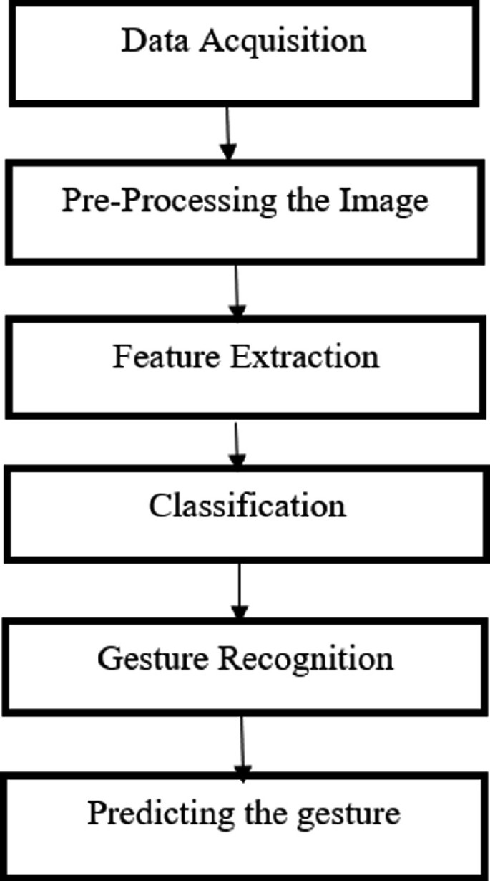
MODELLING
3/21/2024 A nual Review
8
n

Slide 9
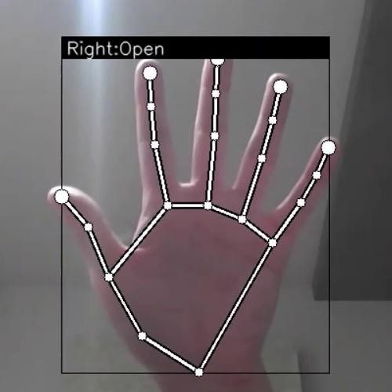
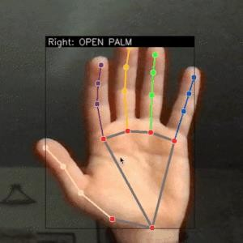
RESULTS
Demo Link
3/21/2024 A nual Review
8
n

